Slide 1
527 Data Analytics
March 21, 2016
Corpus Analysis
Group 7

Slide 2
Introduction
A Corpus is a collections of texts used for linguistic analyses which is usually stored in an electronic database so that data can be accessed easily. Corpus text consists of thousands or millions of words.
Below are the advantages of corpus analysis:
A corpus-based analysis can investigate any language pattern i.e., lexical, structural
It is consistent and reliable.
It allows the linguists to store and analyze larger database of natural language.
We need to install “tm” package for the analyses of the corpus.
Corpus analysis has been performed for the HP company. DEF 14A (Proxy) Filling has been considered for the HP company from 2005 through 2016.

Slide 3
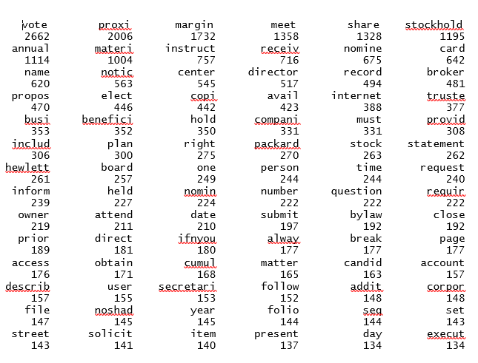
Term Document Matrix of the Q&A content
Below is the code for generating the term document matrix:
#finding the frequency
freq <-colSums(as.matrix(dtms))
freq
Screenshot of the term document matrix:

Slide 4
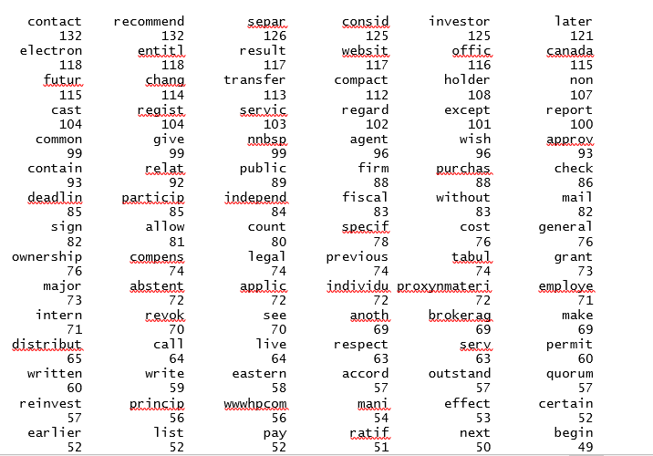
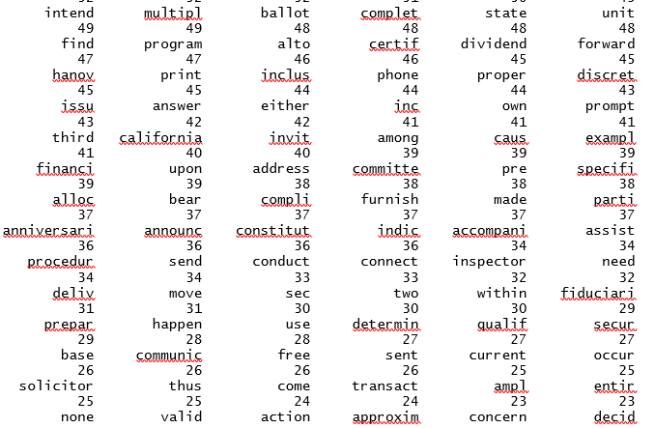
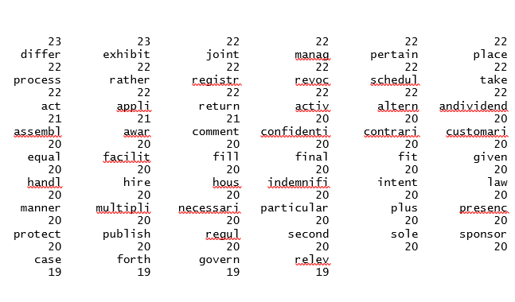
Contd…

Slide 5

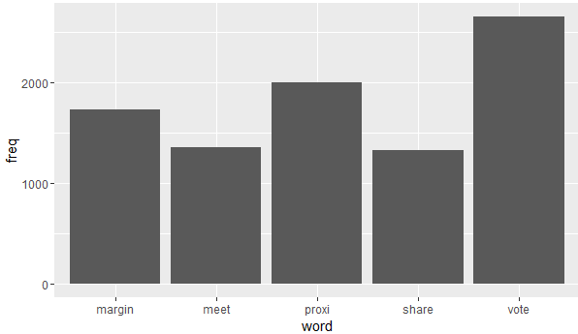
Analytics
Figure 1
Figure 1: The code to find the words which has occurred more than 500 times.
From figure 2, we can find the top five words that has occurred most number of times . The top five words are Margin, Meet, Proxi, Share and Vote.
Figure 2

Slide 6
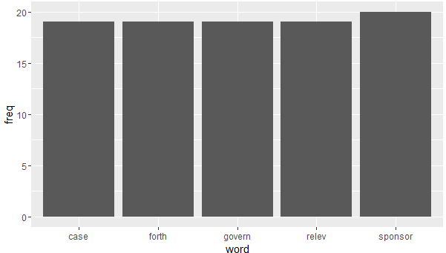
Contd…
Figure 3
Figure 3: The code to find the least five words.
From figure 4, we can find the five words that has occurred least number of times. The least five words are Case, Forth, Govern, Relev and Sponsor.
Figure 4

Slide 7
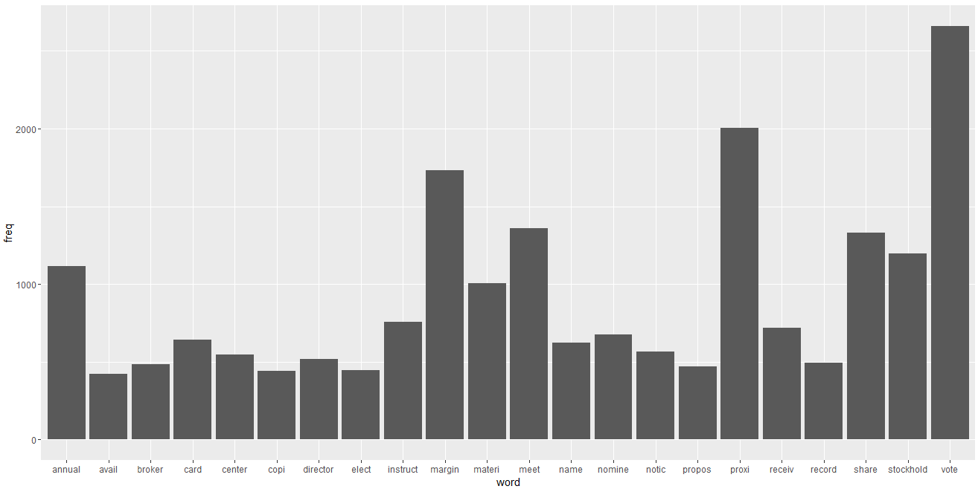
Contd…
From figure 5, we can find the words that have occurred more than 400 times.
From the graph, we can find that “vote” and “proxi” have occurred equal to or more than 2000 times when compared with the other words.
Figure 5
Number of occurrence equal to or more than 2000

Slide 8
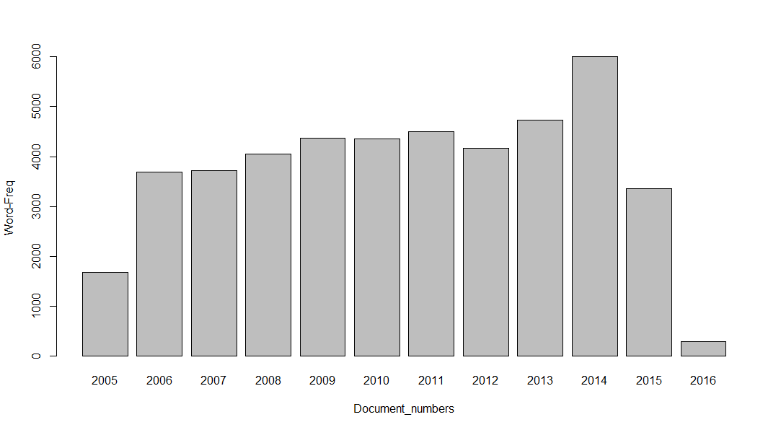
Contd…
Figure 6
Figure 6: The code to find word count in a particular document for the respective years.
From figure 7, we can find the word count in a particular document for the years 2005 through 2016. Year 2014 has highest word count when compared with the other years.
Figure 7

Slide 9
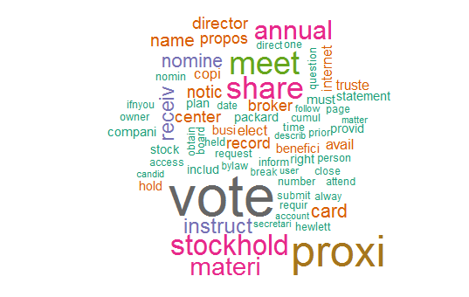
Conclusion
Figure 8 is the word cloud after converting all the words to lower case, removing numbers, stop words, punctuations, white spaces, sparse items etc.
Below is the code which generates the following word cloud:
set.seed(123)
wordcloud(names(freq),freq,min.freq =150,scale=c(4,0.5),colors=brewer.pal(8, "Dark2"))
Figure 8

